Slide 1
Simulation Modeling Analysis
Review of Basic Probability and Statistics
Md. Fazlul Karim Patwary
Professor
Institute of Information Technology Jahangirnagar University

Slide 2
Motivation
Simulation is more than flowchart and programming
Need to apply probability and statistics in various stages
Model a probabilistic system
Choose the input probability distributions
Generate random numbers from given distributions
Perform statistical analyses of the simulation output data
Validate the simulation models

Slide 3
Outline
Probability Models, Conditioning and Independence
Random Variables: Discrete vs. Continuous
Distribution, Mean, Average, Variance
Covariance and Correlation
Hypothesis Testing, Maximum Likelihood Estimation, and Least Mean Squared Error Estimation

Slide 4
Probability Model
Experiment: a process with uncertain outcome
Sample space S: set of all possible outcomes of an experiment
Sample points (outcome): elements of sample space
Examples:
For the experiment consists of flipping a coin:
Ω = {H, T}
For the experiment consists of tossing a die: Ω = {1, 2, 3, 4, 5, 6}

Slide 5
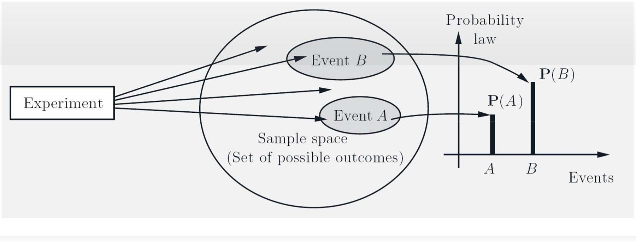
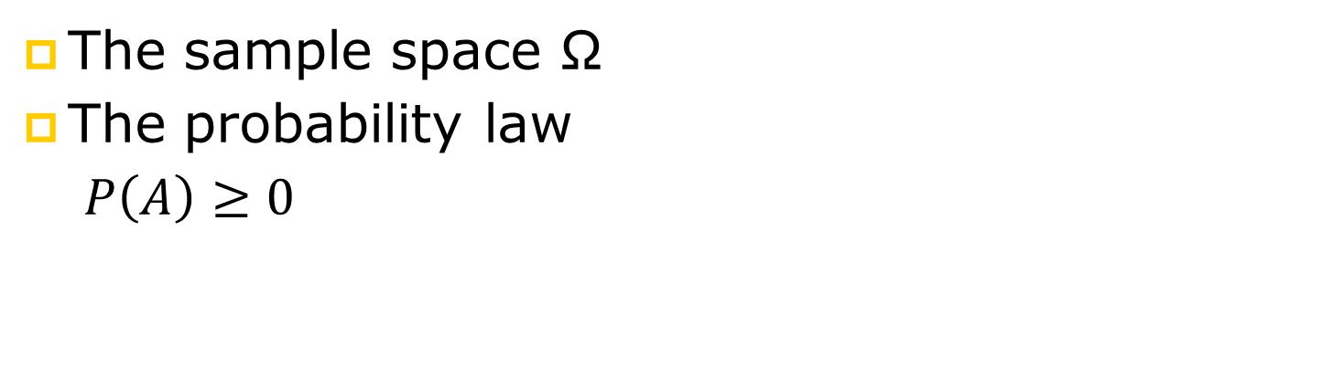
Probability Model
The sample space Ω
The probability law
$P\left(A\right)≥0$
$$P\left(A∪B ∪C ∪ …..\right)=P\left(A\right)+P\left(B\right)+P\left(C\right)+ ….$$

Slide 6
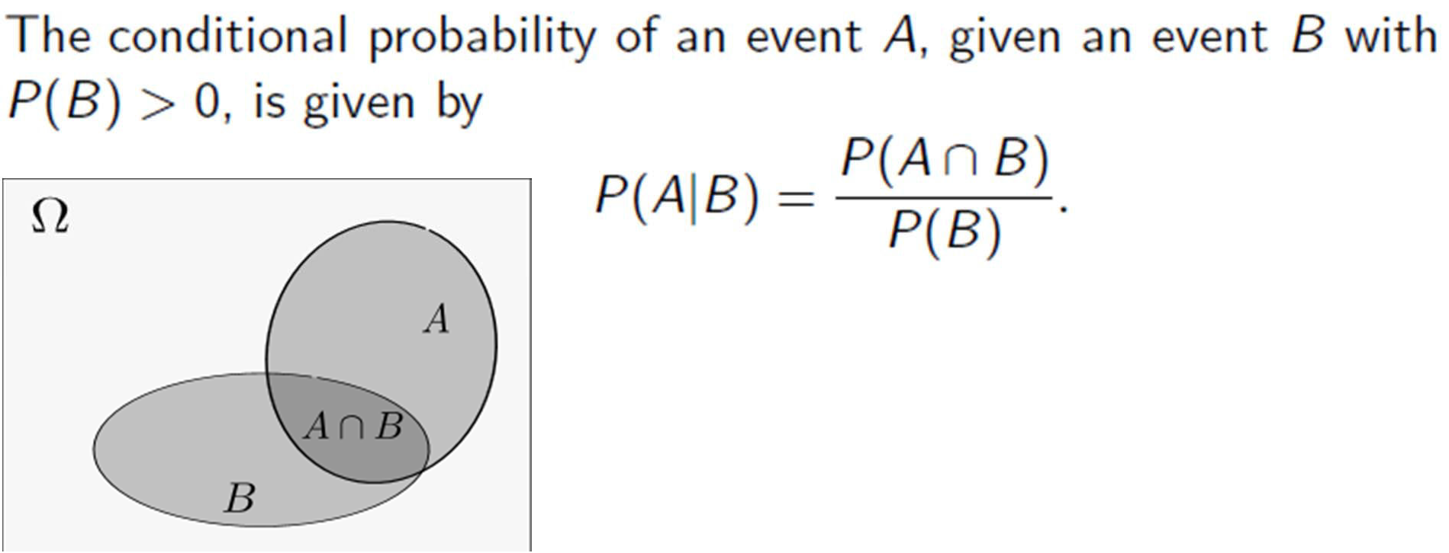
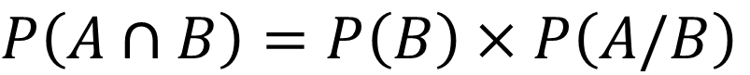
Conditional Probability
 | Male | Female | Total
Have Laptop | 90 | 40 | 130
No Laptop | 40 | 30 | 70
Total | 130 | 70 | 200
$$P\left(A∩B\right)=P\left(A\right)×P\left(B/A\right)$$
$$P\left(A∩B\right)=P\left(B\right)×P\left(A/B\right)$$
$P\left(Male∩Have\right)=P\left(Have\right)×P\left(Male/Have\right)$=130/200 x 90/130=90/200

Slide 7
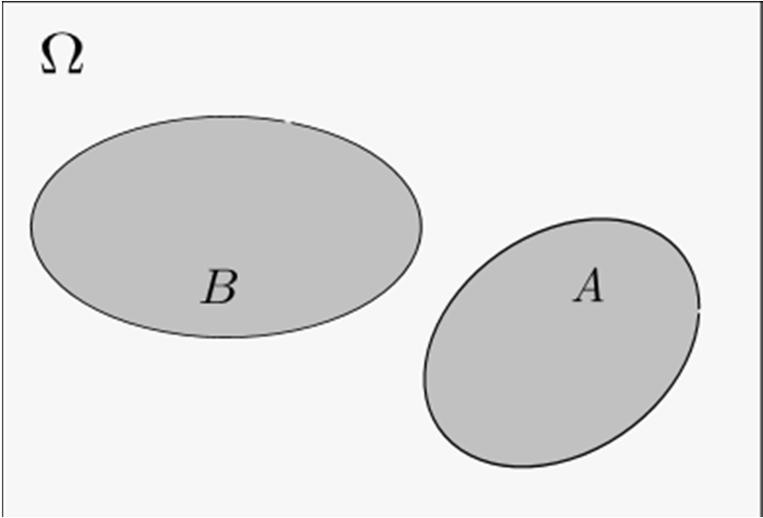
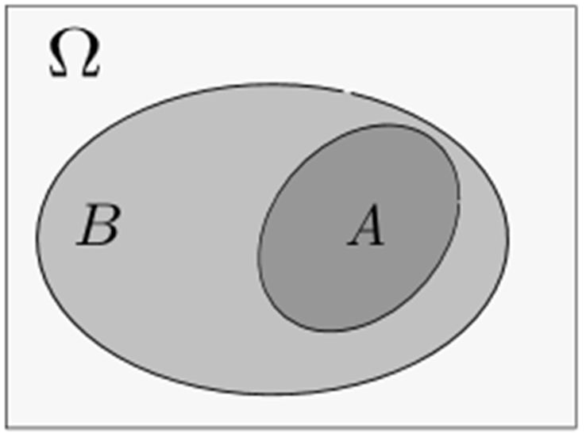
Independence
Events A and B are independent if
Are A and B in the examples independent?
$P\left(A∩B\right)=P\left(A\right)×P\left(B\right)$ i.e. $P\left(B\right)$=$P\left(B/A \right)$

Slide 8
Exercise
The release of 2 out of 3 prisoners has been announced, but their identity is kept secret. One of the prisoners considers asking a friendly guard to tell him who is the prisoner other than himself that will be released. But he hesitates due to the following rationale: at his present state of knowledge, he has 2/3 probability to be released; but after he knows the answer, the probability will drop to 1/2, since there will be two prisoners (including himself) whose fate is unknown and exactly one of the two will be released. What is wrong with his reasoning?

Slide 9
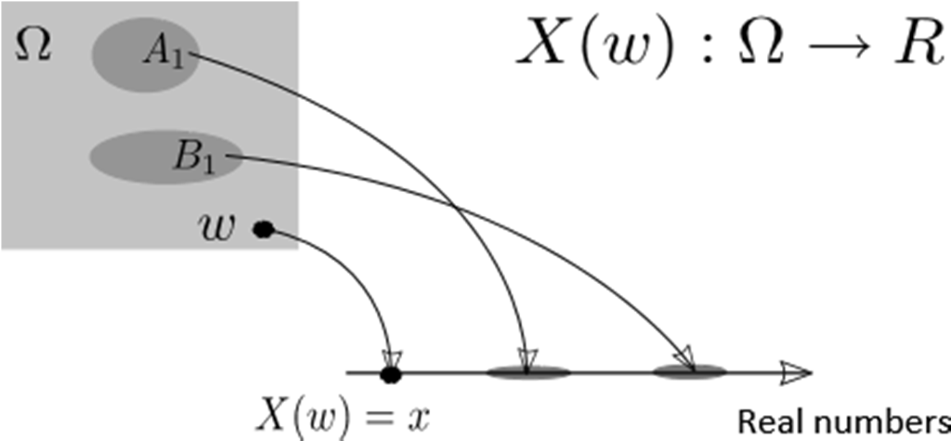
Random Variable
A deterministic function from each sample point to a real number

Slide 10
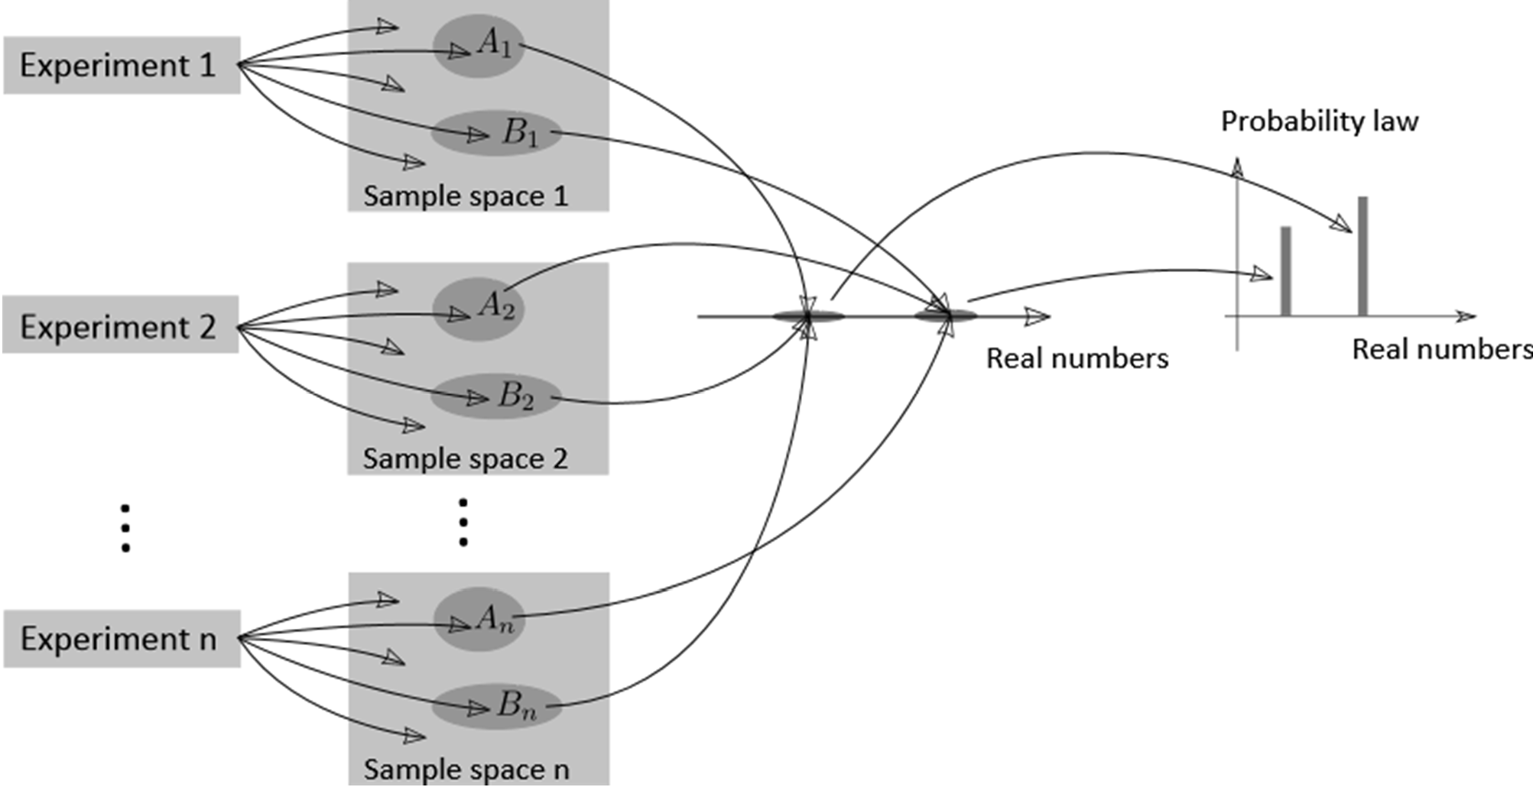
Why Introducing Random Variable
Sometime, we are interested in functions of the outcome, e.g., expectation

Slide 11
Key Issues in Simulation
Example: Coin Flipping: Ω ={H, T}
Let X be the random variable corresponding to the outcome of the coin flipping
We can assign a value to X according to the outcomes
X = 1 if the outcome is H
X = 0 if the outcome is T
Notations
Capital letters: random variables, X, Y, Z
Lowercase letters: values of random variables, x, y, z
E.g. X denotes the “class size of IT3109 2014”
X < x where x = 40 ⇒ the class size is smaller than 40

Slide 12
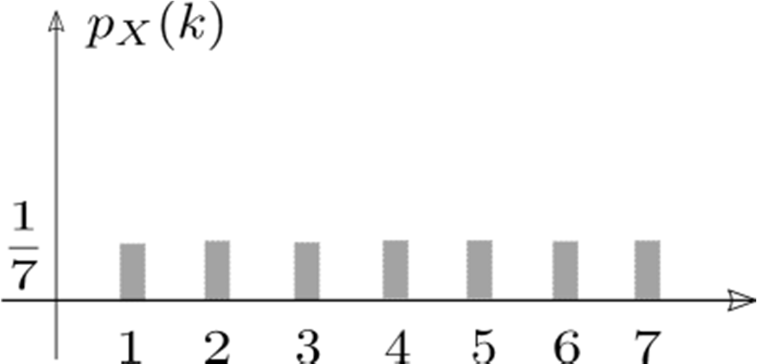
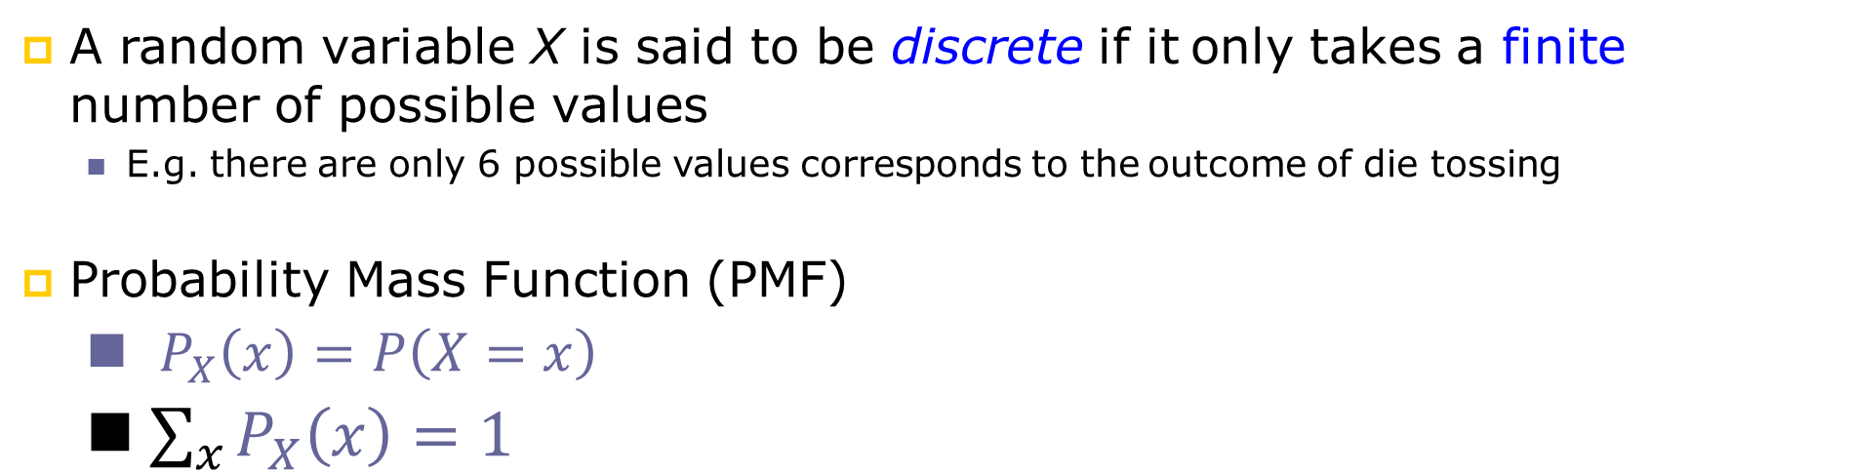
Discrete Random Variables
A random variable X is said to be discrete if it only takes a finite number of possible values
E.g. there are only 6 possible values corresponds to the outcome of die tossing
Probability Mass Function (PMF)
$P_{X}\left(x\right)=P\left(X=x\right)$
$\sum_{x}{P_{X}\left(x\right)=1}$

Slide 13
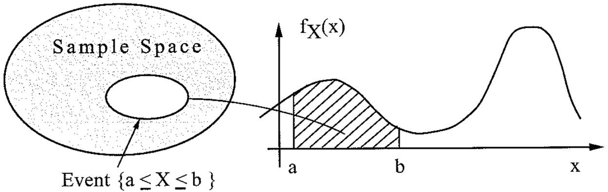
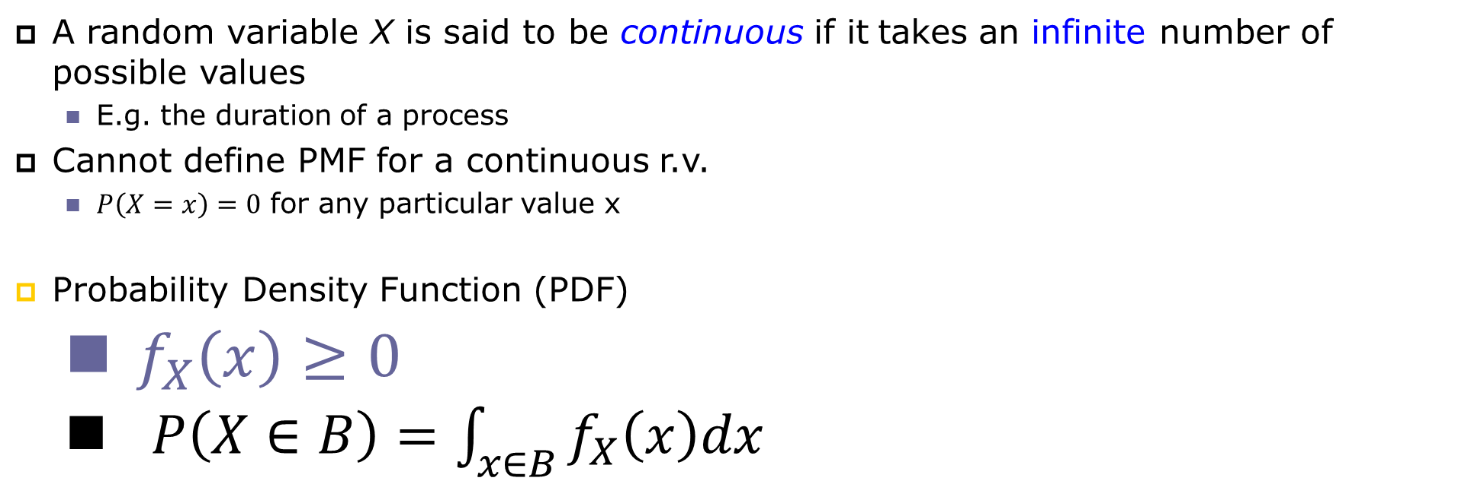
Continuous Random Variables
A random variable X is said to be continuous if it takes an infinite number of possible values
E.g. the duration of a process
Cannot define PMF for a continuous r.v.
$P\left(X=x\right)=0$ for any particular value x
Probability Density Function (PDF)
$f_{X}\left(x\right)≥0$
$P\left(X∈B\right)=\int_{x∈B}^{ }{f_{X}\left(x\right)dx}$

Slide 14
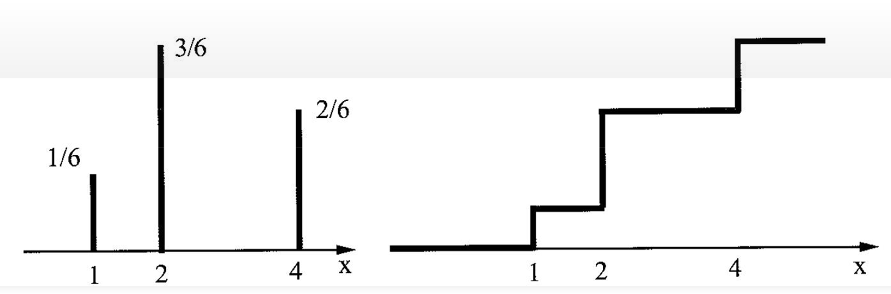
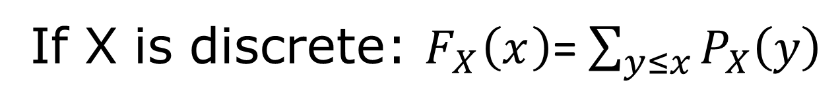
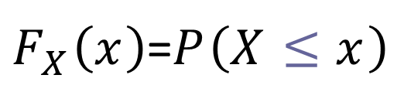
Cumulative Distribution Function
CDF of an r.v. X, denoted by $F_{X}\left(x\right)$ is defined as
$F_{X}\left(x\right)$=$P\left(X≤x\right)$
If X is discrete: $F_{X}\left(x\right)$= $\sum_{y≤x}^{ }{P_{X}\left(y\right)}$
?

Slide 15
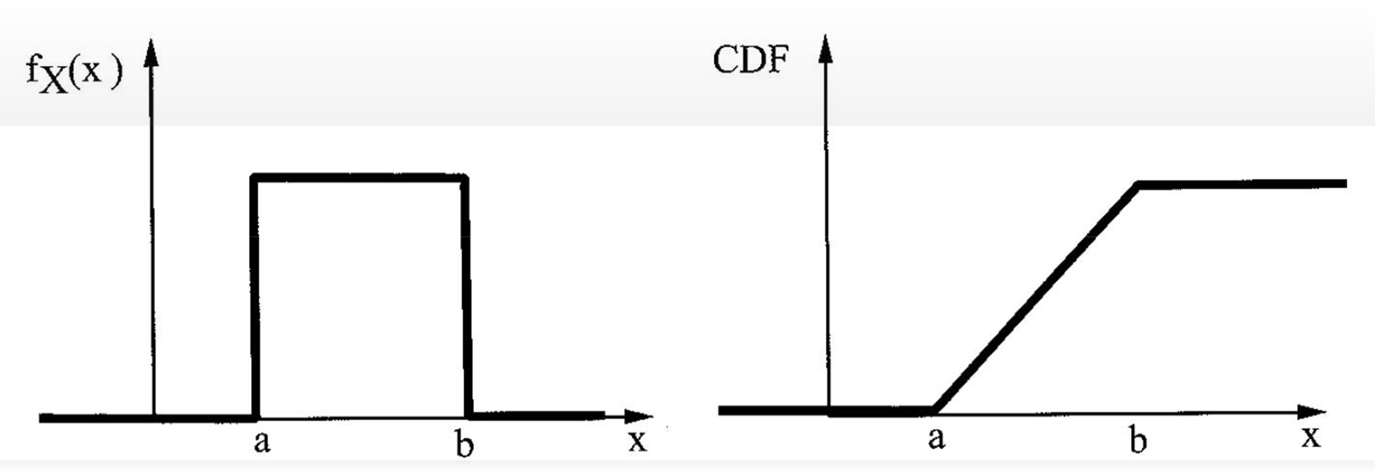
Cumulative Distribution Function
CDF of an r.v. X, denoted by $F_{X}\left(x\right)$ is defined as
$F_{X}\left(x\right)$=$P\left(X≤x\right)$
If X is continuous: $F_{X}\left(x\right)=\int_{y≤x}^{ }{f_{X}\left(y\right)}dy$

Slide 16
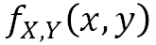
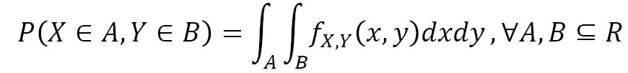
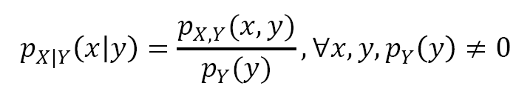
Joint PMF and PDF
For discrete r.v.s X and Y, defined their joint PMF
For continuous r.v.s X and Y, defined their joint PDF as
so that
Conditional distribution

Slide 17
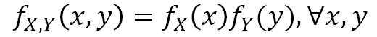
Independence of Random Variables
Two discrete random variables X and Y are said to be independent if
Two continuous random variables are said to be independent if
Intuitive explanation: knowing X doesn’t tell any information about Y

Slide 18
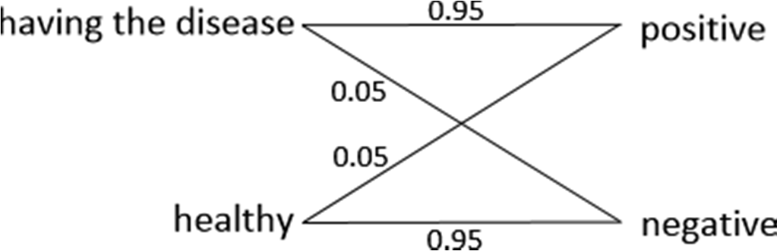
Exercise
Any person in HK has a disease with 0.1% chance
A lab has developed a 95%-accuracy test for detecting the disease
If the person has the disease, then the test gives positive result with 95% chance
If a person don’t have the disease, then the test gives negative result with 95% chance
Question: Given that the person tested positive, what is probability that he/she has the disease?

Slide 19
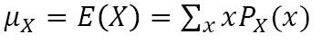
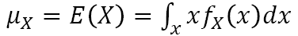
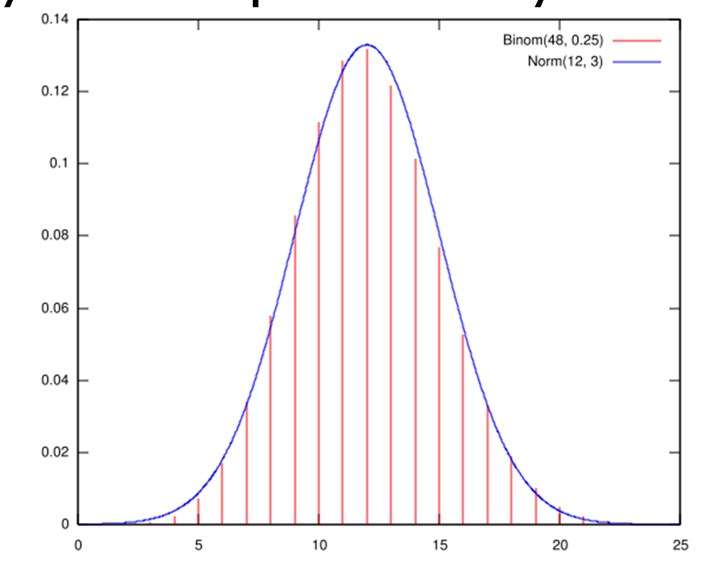
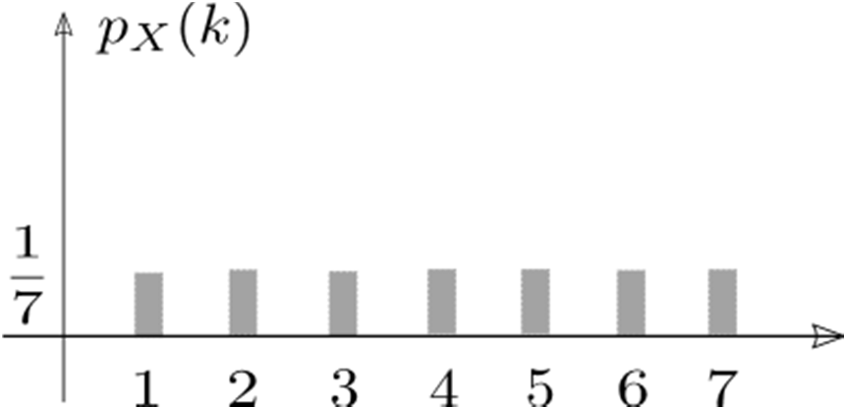
Mean (Expected Value)
µ_{x} or E(X)): the mean of the random variable X
It is a weighted sum of the values of X
■ If X is discrete:
If X is continuous:
It is the center-of-gravity of the probability mass

Slide 20
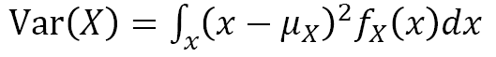
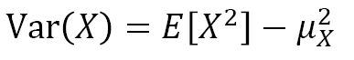
Variance
Var(X): variance is the expected value of the square distance from the mean
how the probability mass concentrates around the mean
Discrete variable:
Continuous variable:
Exercise: derive the following formula:

Slide 21
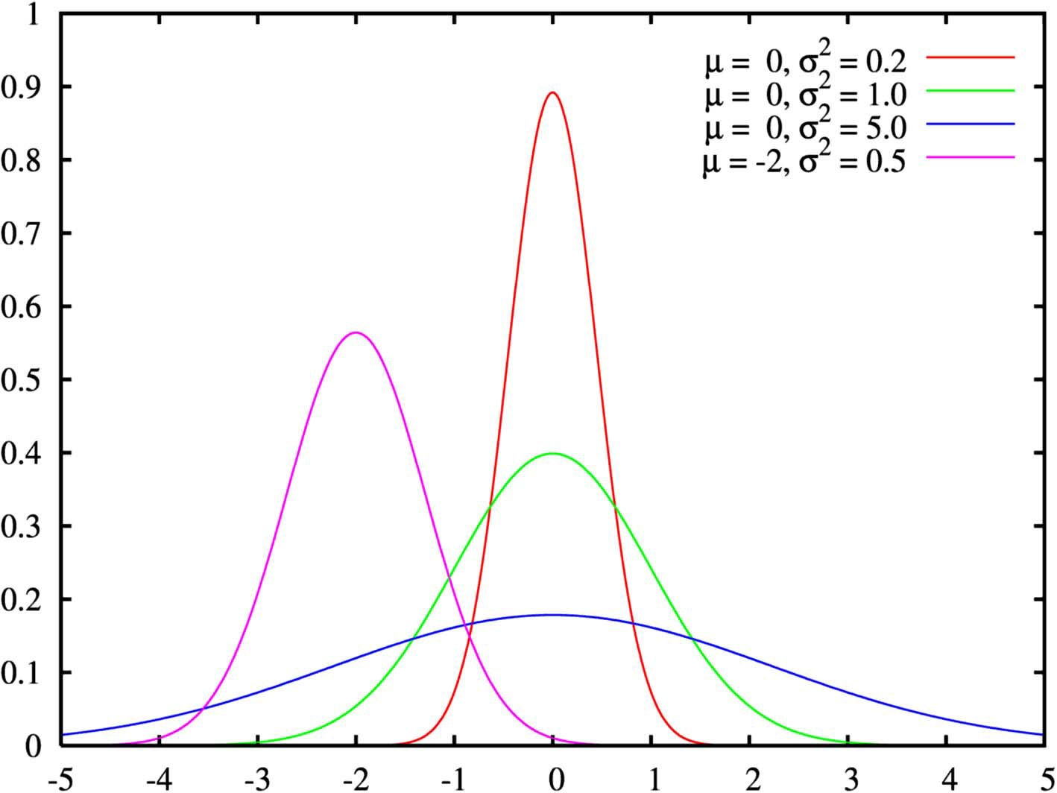
Variance
Larger variance implies “flatter shape” of probability mass

Slide 22
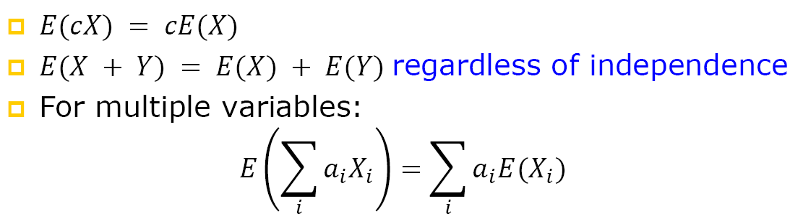
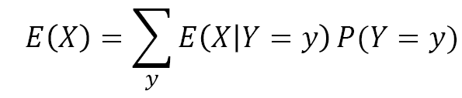
Properties of Expectation
Expectation is a linear operation
Total expectation law: X, Y are two discrete r.v.s

Slide 23
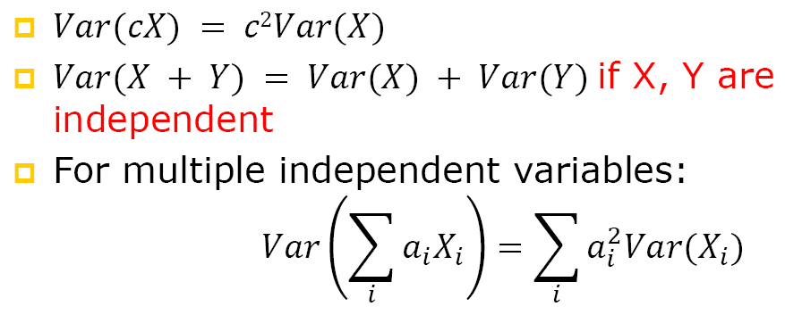
Properties of Variance
Variance is a nonlinear operation
Total variance law: X, Y are two discrete r.v.s

Slide 24
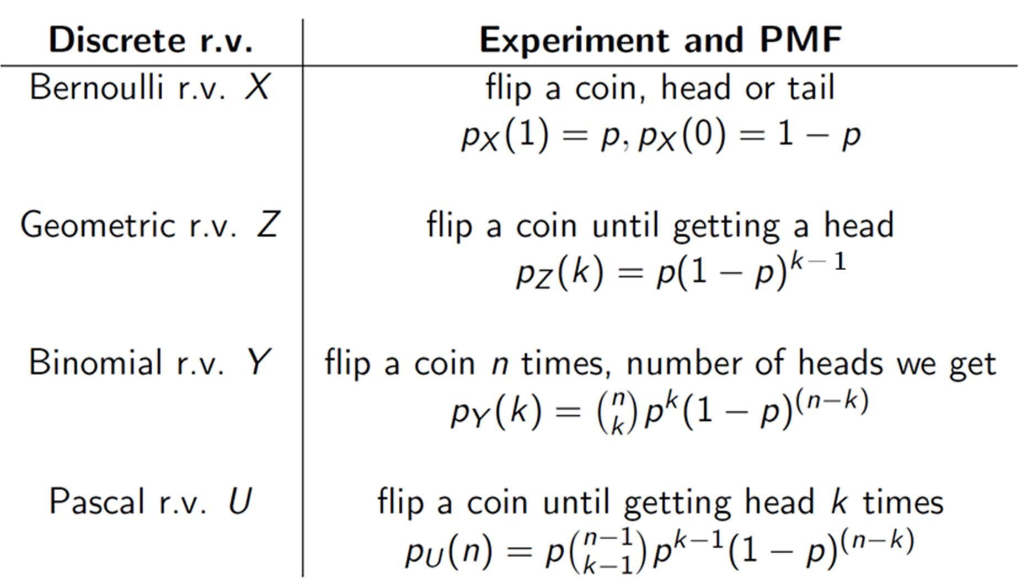
Discrete Random Variables
Exercise: computing the mean and variance for Binomial r.v.

Slide 25
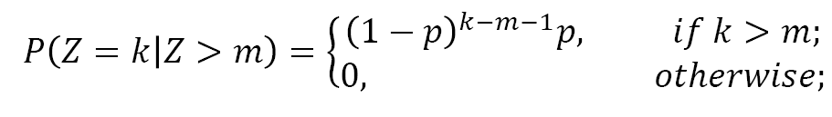
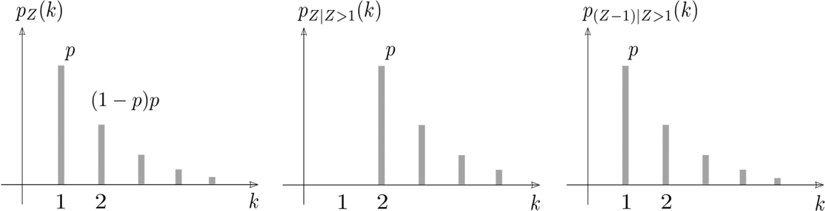
Geometric Random Variable
The only memoryless discrete r.v.
Memoryless property: Given that a Geometric r.v. Z > m, Z-m has the same PMF as Z:

Slide 26
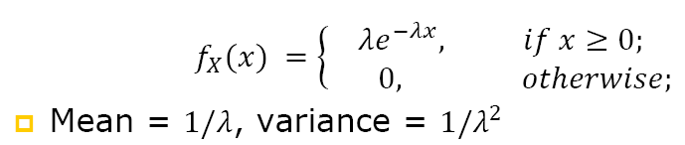
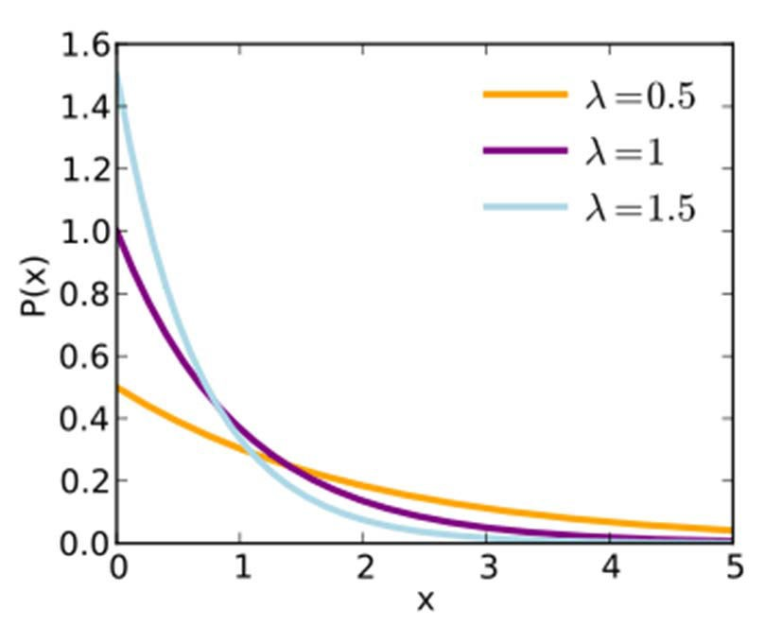
Exponential Random Variable
The only memoryless continuous r.v. An exponential r.v. X has a PDF

Slide 27
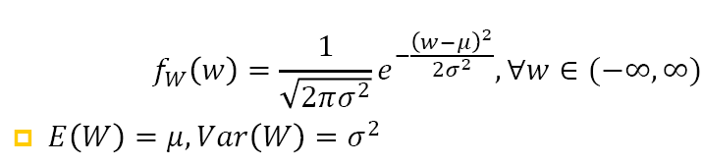
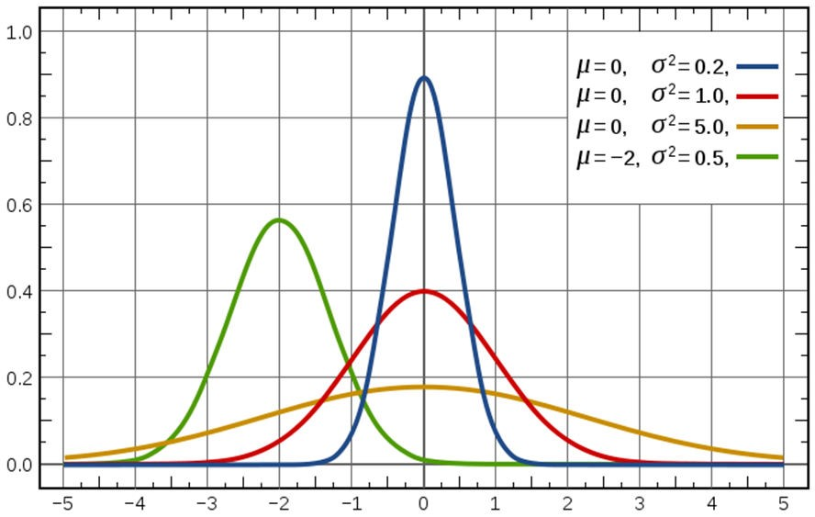
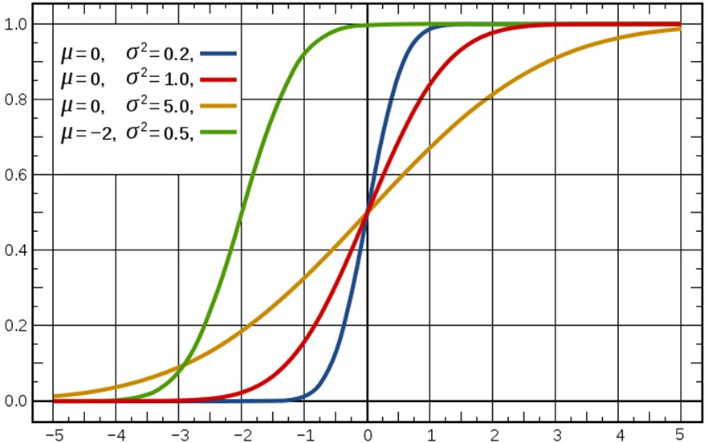
Gaussian Random Variable
A Gaussian random variable W has a PDF

Slide 28
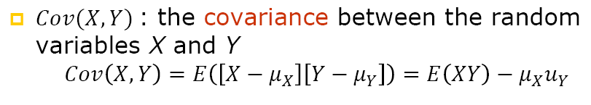
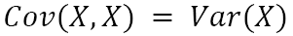
Covariance
It measures dependence between X and Y
If statistically, X is large implies Y is also large, then we say X and Y are positively correlated
❐ Note that

Slide 29
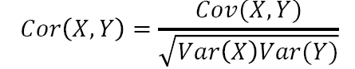
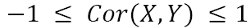
Covariance and Correlation
Cor(X,Y): correlation coefficient between the random variables X and Y

Slide 30
Exercise
Prove that independent random variables are uncorrelated
Construct two r.v.s X and Y, that are uncorrelated but NOT independent

Slide 31
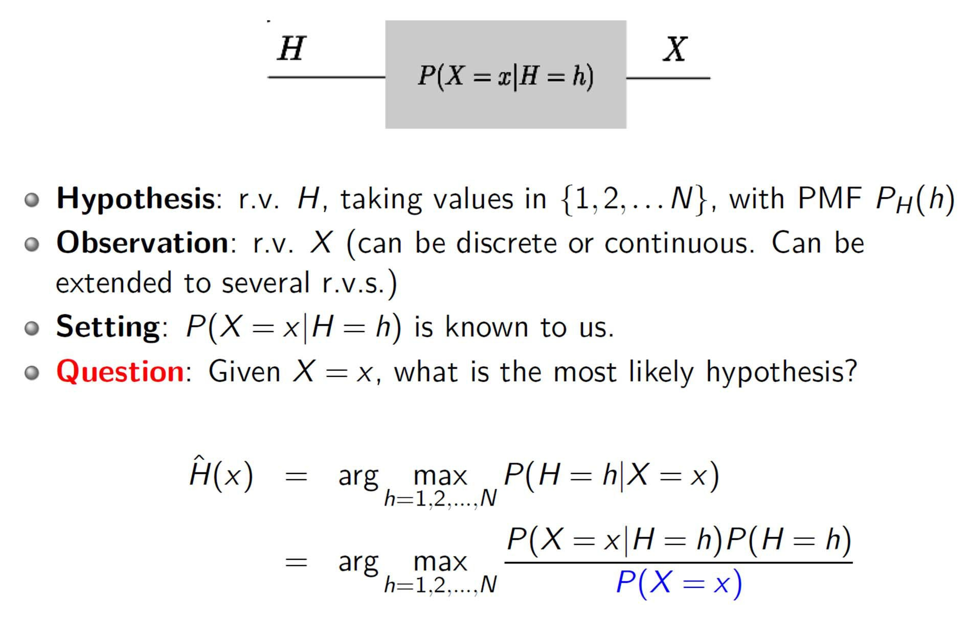
Hypothesis Testing

Slide 32
Hypothesis Testing

Slide 33
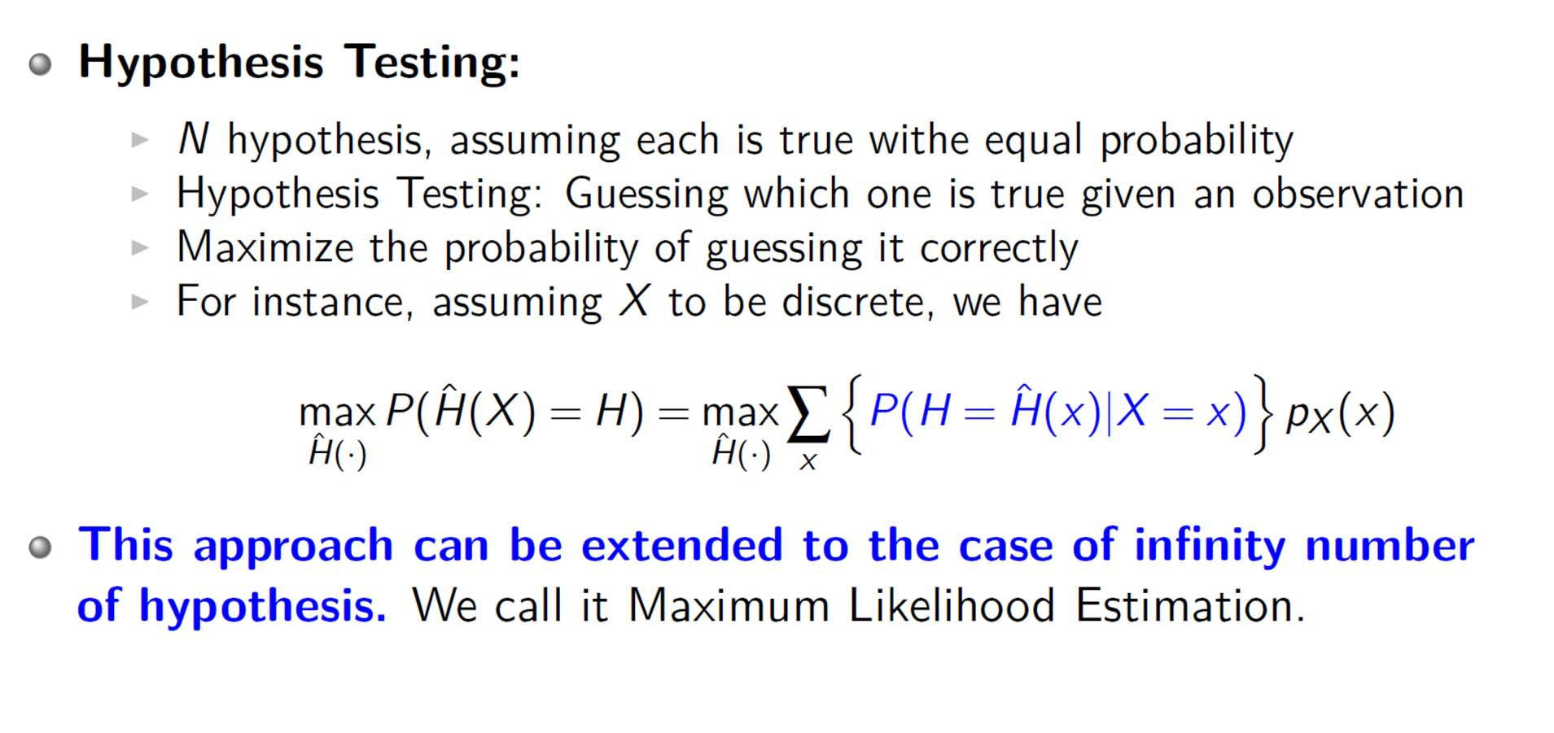
Maximum Likelihood Estimation

Slide 34
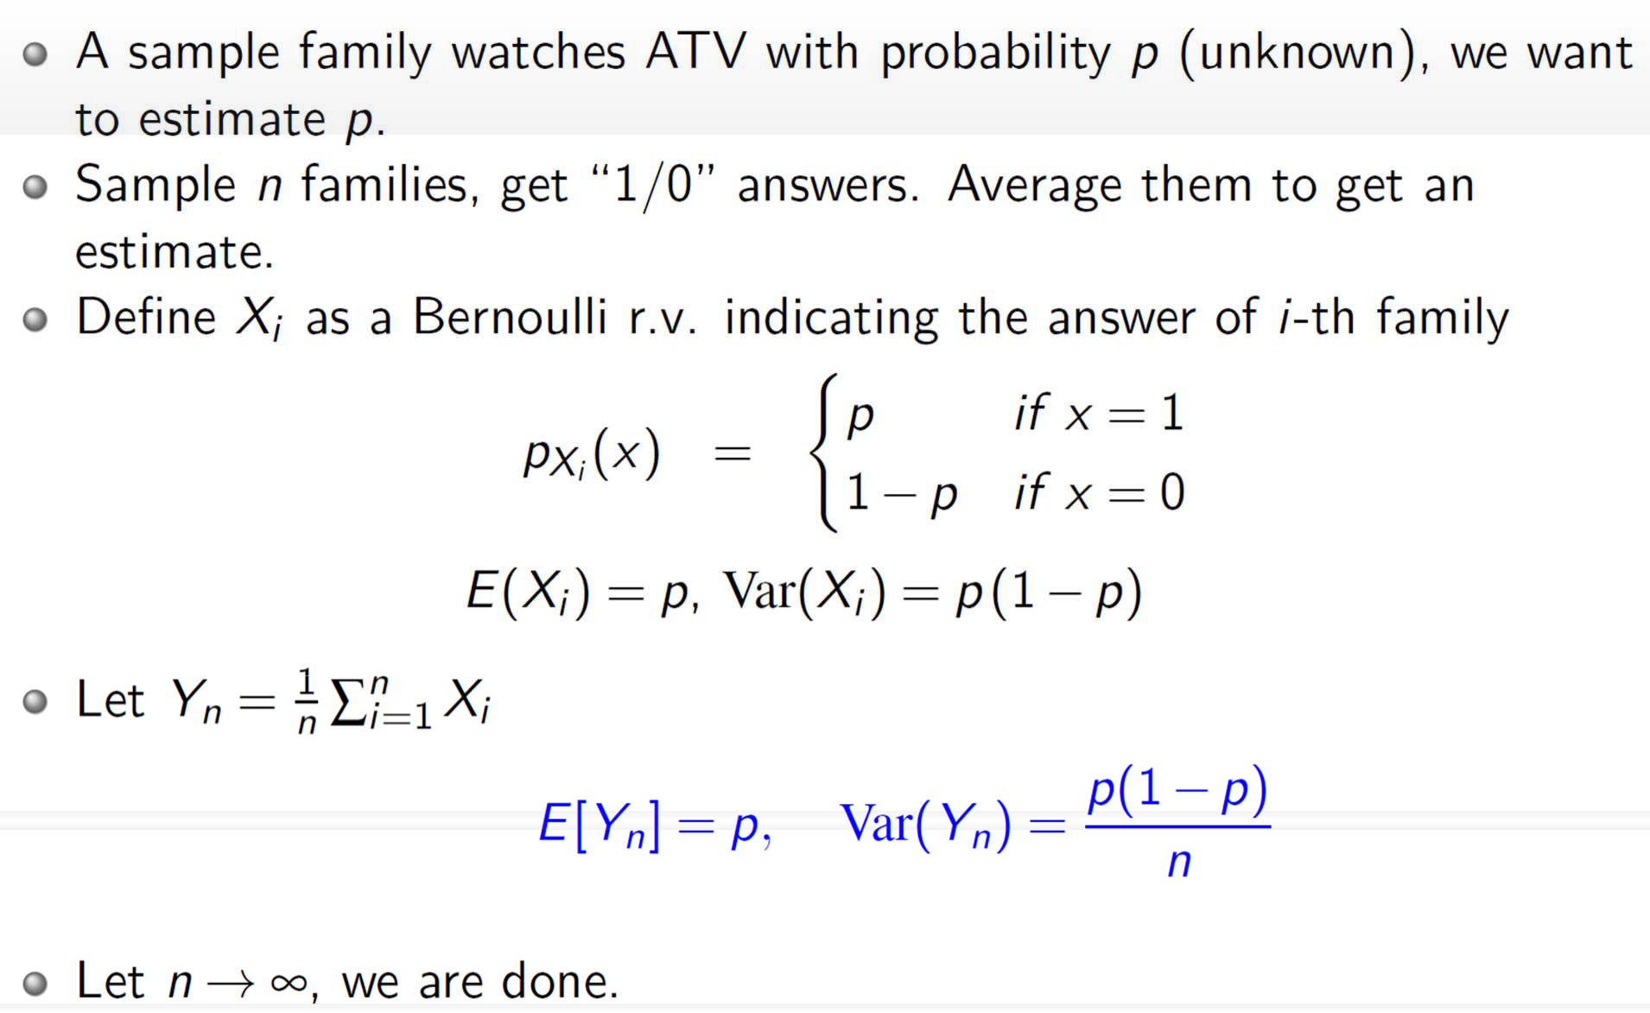
ATV Poll Problem

Slide 35
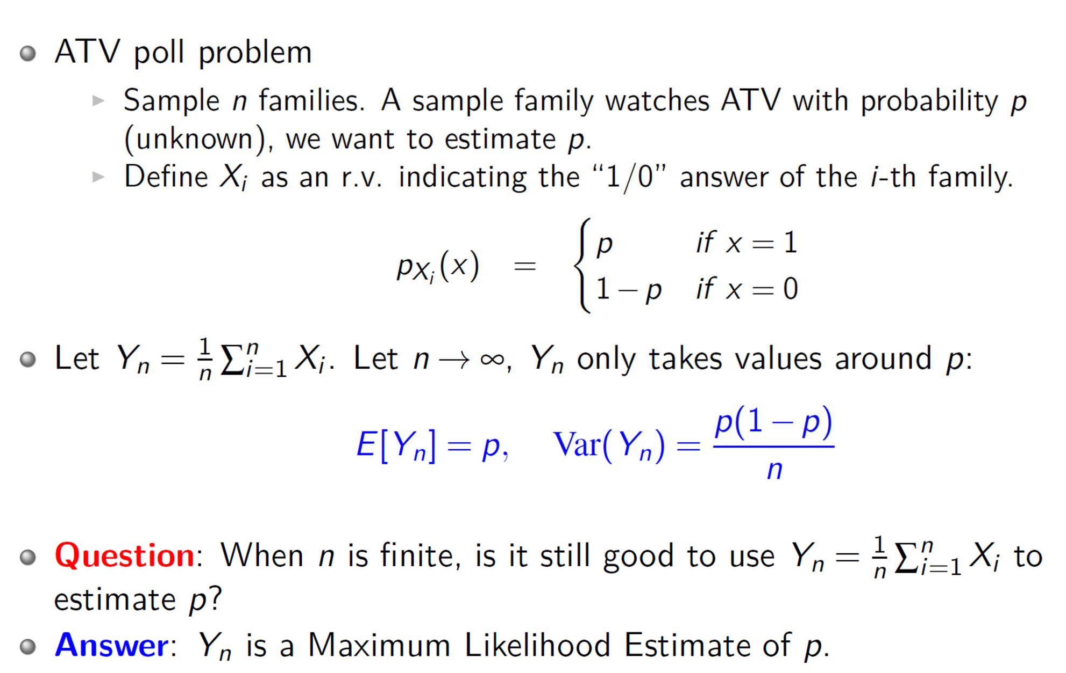
Maximum Likelihood Estimation

Slide 36
Mean and Average
Mean: the “center” of the entire population
E.g. the mean height of the entire population of IERG3050
Average: the “center” of a sample of the population
E.g. we pick up some 10 students from the IERG3050 class
The average height of these 10 students
Average is an estimator of the mean
An estimator is unbiased when the sampling distribution of the samples is the same as the distribution of the population itself

